Slide 1
Examining the Waveform of Resonant EMRIs vs Single EMRIs
Christopher Goodhart

Slide 2
Purpose
To determine if we can detect a resonant EMRI signal, or if the signal will be confused with another type of system.

Slide 3
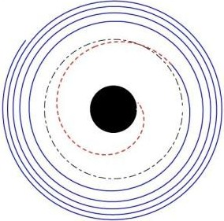
Introduction
EMRI (Extreme Mass Ratio Inspiral)
System of at least two black holes
One is at least 10,000 times more massive
Smaller ones orbits and spirals inward
Orbit decays because EMRI emits gravitational waves

Slide 4
Introduction
Some EMRIS will have multiple smaller bodies
These smaller bodies can form resonant orbits
Whole number ratio between orbits
Can we detect resonant EMRIs with standard methods?

Slide 5
Past Research
A single EMRI with an external tidal field
Worked on detection methods (time and parameters)
Worked on differentiating between signals and glitches

Slide 6
Importance
Gravitational waves are a way to see the universe
EMRIs are a great source of gravitational wave signals
Signals have abundant information
Locate the EMRI system
Provide us information about black holes (mass, eccentricity, etc.)
Locate supermassive black holes
Learn about formation of supermassive black holes

Slide 7
Hypothesis
The signal from a resonant EMRI will differ from a single EMRI, requiring a change in detection methods.

Slide 8
Variables
Independent variable: Number of EMRIs
Dependent variable: Gravitational wave signal
Constants: As many parameters as possible
Mass, angular momentum, charge, spin
Control: Single EMRI

Slide 9
Method
Use Python to simulate EMRI systems
Model the waveforms of various EMRIs
Compare the waveforms of resonant EMRIs to single EMRIs

Slide 10
Simulation (Step 1)
Input parameters (mass, number of EMRIs, angular momentum)
Simulation runs, displaying the orbit of EMRIs overtime before collision
Run simulation for both single EMRIs and resonant EMRIs

Slide 11
Modelling Waveform (Step 2)
For each simulation, create a model of the gravitational wave signal
Waveform is graphed overtime with the model
Create the waveform for single EMRIs and resonant EMRIs

Slide 12
Compare Waveforms (Step 3)
Look for defining characteristics of the signal
Look for major differences that show up
Can resonant EMRIs be detected with current techniques?
What can be used to detect EMRIs?

Slide 13
Feasibility
Need a laptop that can run python
Internet access
Need python packages to program simulation
No risks involved

